Slide 1

NYSE DATA PROJECT

Slide 2
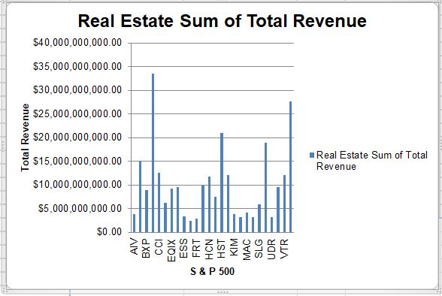
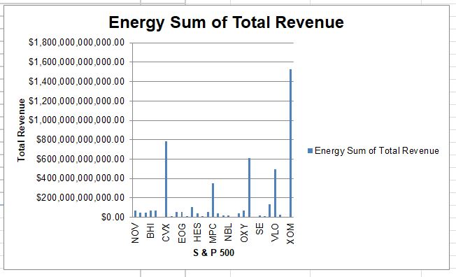
Does the real estate sector have similar expenditure levels for Sum of Total Revenue than the Energy sector in Year 1?
Here are the bar charts for the annual SRT(Sum of Total Revenue) expenses for real estate and energy sector companies as reported for S&P 500 companies in Year 1.
Both distributions are bar charts.
The mode for real estate is about $34 billion and for energy is around $1.8 Trillion. This means that most of the companies from that sector make $50 Billion in SRT. Furthermore the median for real estate($22.5 billion) is not even close to the median for energy ($10 Trillion). It looks like that 50% of the companies in the Energy sector have a higher SRT on average than 50% of the companies categorized under Real Estate Sector. The standard deviation for Energy is quite lower ($5 Billion) and $11 billion for real estate companies). The variability in SRT expenses for real estate S&P companies is higher with more S & P companies spending above $131 Billion and more than 65% of the energy companies spending close to $27 billion each year on SRT expenses.
The range for Energy sector Total Revenue at $1.3 Trillion is higher compared with the range of Total Revenue for the Real Estate sector at only 33.5 billion. It looks like companies in the Energy sector have greater variability in the total revenues they receive because their range is more spread out.

Slide 3
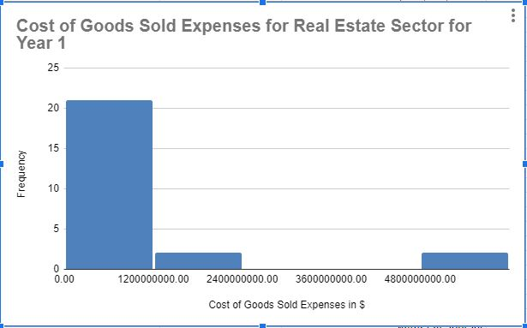
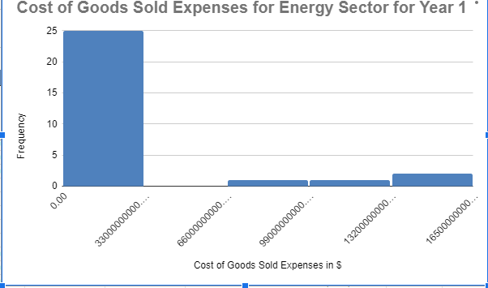
Does the real estate sector have similar expenditure levels for Cost of Goods sold than the Energy sector in Year 1?
Here are the histograms for the annual COGS(Cost of Goods Sold) expenses for real estate and energy sector companies as reported for S&P 500 companies in Year 1.
Both distributions are right-skewed/positively skewed meaning the mean for each is higher than the median.
The mean for real estate is about $981 million and for energy is slightly above $22 billion. It looks like companies in the Energy sector have a higher SRT on average than all sectors categorized under Real Estate. Furthermore the median for real estate($625 million) is double the median for energy ($3 billion). That means, the variability in COGS expenses for Energy companies is higher, with more companies spending above $1.6 Trillion and more than 25% of the Real Estate companies spending more than $66 billion. The standard deviation for Energy is quite higher ($46 Billion for Energy and 1 billion for real estate companies). This means that the variability in COGS expenses for energy S&P companies is higher with more S & P companies spending above $163 Billion and more than 65% of the energy companies spending more than $656 billion each year on COGS expenses.
The range for Energy sector Total Revenue at a frequency of 25 is higher compared with the Total Revenue for the Real Estate sector at a frequency of 20. It looks like the Energy sector have greater variability in the total revenues because their frequency range is more spread out,

